Slide 1
Generative Feature Language Models for Mining Implicit Features from Customer Reviews
Speaker: Jim-an tsai
advisor: professor jia-lin koh
Author: Shubhra Kanti Karmaker Santu，Parikshit Sondhi，ChengXiang Zhai
Date: 2017/10/3
Source: CIKM’16

Slide 2
outline
Introduction
Method
Experiment
Conclusion

Slide 3
Motivation

Slide 4
Purpose
Mining Implicit Features from Customer Reviews!!
Propose a new probabilistic method for identication of implicit feature mentions.
Ex:
Review: The phone fits nicely into any pocket without falling out.
Feature: “size” <<< BUT cannot detect “size” in this review.

Slide 5
framework
Input
Method
Output
Generative Feature Language Model
Reviews
Has feature or not
(1 or 0)

Slide 6
outline
Introduction
Method
Experiment
Conclusion

Slide 7
Problem formulation
Assumption: Review sentences with explicit feature mentions have already been labeled using a traditional dictionary lookup based approach.
Goal: Label all remaining implicit feature mentions in the dataset.
Input: Review set R, feature set F, a subset of Aijk entries already known to be 1
Output: 0 or 1 values assigned to the remaining Aijk entires.
Ex:
For cell phones, fi may be "size" or "battery life".
Aijk are binary variables(1 or 0) which take a value1 if sij mentions feature fk (either explicitly or implicitly, eg: size or battery life) and 0 otherwise.

Slide 8
A Generative Feature Language Model
Key idea: Unigram language model
Ex: if “size” is a feature for the unigram language model
P(size) of word “pocket” will get high score
P(size) of word “friendly” will get low score

Slide 9
Perfect condition??
Suppose we can estimate an accurate feature language model for every feature.
It would be easy to do:
1. Compute the probability of a candidate sentence using each feature language model
2. Tag the sentence with features whose feature language models give the sentence a sufficiently large probability.

Slide 10
A Generative Feature Language Model

Slide 11
Parameter Estimation in training
c(w, S) is the number of times word w appears in sentence S.
C(fi,w) is the number of times fi and w occur explicitly in the same sentence.
C(w) is the number of review sentences where word w appears at least once.

Slide 12
Background language model
Training
Testing

Slide 13
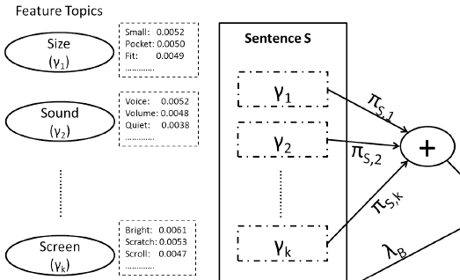
Feature Topics
Training
Testing

Slide 14
Parameter Estimation in testing
Use EM algorithm
First give a randomly assigning values to all the parameters to be estimated, eg:
Ex: consider the generation of a word "pocket“
E-step
1. compute the probability the background model generated word "pocket“
2. if not background, then it is generated from which feature topics. Eg. "size", "sound", "screen“,etc.
3. Figure that P("pocket"|"size") is the highest score than other features.

Slide 15
Parameter Estimation in testing
M-step
Consider a sentence: "There were scratches on the display. Its very annoying."
1. Find the words "scratches" and "display“, the rest of words are mostly background words.
2. Figure that the fraction for feature "screen" is most likely to be larger than the features "size" and "sound".

Slide 16
Implicit Feature Prediction
GFLM-Word
At each word w and adds a feature f to the inferred implicit feature list X(S) if and only p(zS,w = f)*(1 - p(zS,w =B)) is greater than some threshold θ for at least one word in S.
GFLM-Sentence
At the contribution of each feature f in the generation of the sentence, i.e and infers f* as an implicit feature only if is greater than some threshold θ.

Slide 17
outline
Introduction
Method
Experiment
Conclusion

Slide 18
Dataset

Slide 19
Result

Slide 20
Result

Slide 21
outline
Introduction
Method
Experiment
Conclusion

Slide 22
Conclusion
Mining implicit feature mentions from review data is an important task required in any applications involving summarizing and analyzing review data.
We proposed a novel generative feature language model to solve this problem in a general and unsupervised way.

